Slide 1
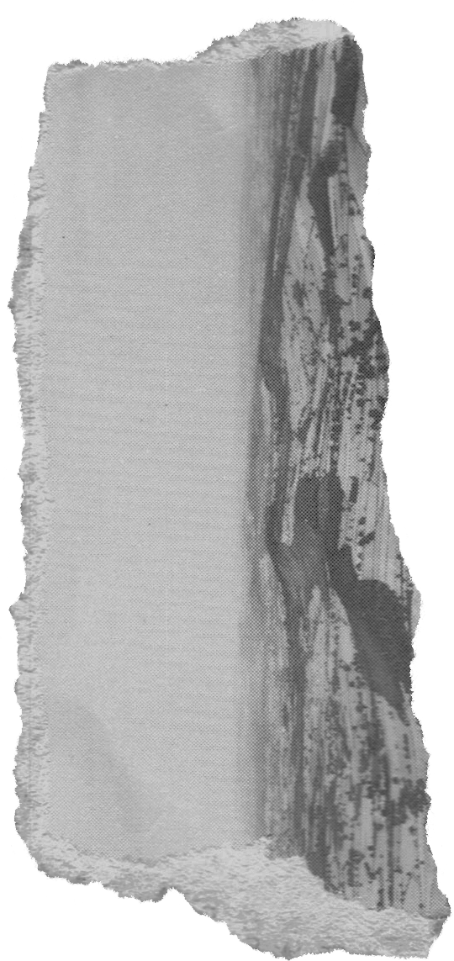






MẠNG MÁY TÍNH
Ths. Nguyễn Thanh Cẩm

Slide 2







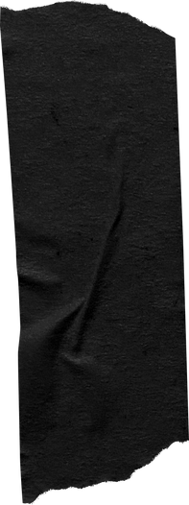
Table of contents
Basic concepts of TCP protocol
Port
IP address (Address)
Steps to create a TCP application

Slide 3


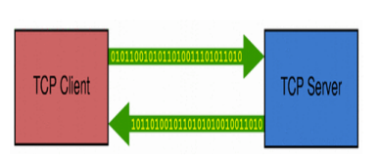




Basic concepts of TCP protocol
TCP Is a protocol-oriented connection (connection - direction).
Reliable information transmission.
Channel connection setup

Slide 4
Basic concepts of TCP protocol
Provides a point-to-point channel for applications requiring reliable communications.
The following protocols are connection oriented protocols:
HTTP
FTP
Telnet

Slide 5


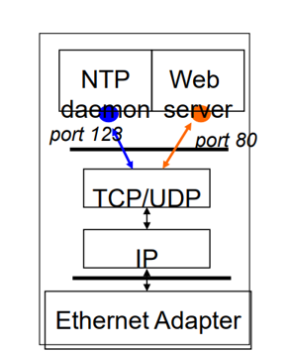

Post
Port number is 2 bytes •
Numbers 0-1023: for applications
Number 1024-65535 : are ports
Servers often use well-known ports
Purpose: any client can easily identify the server/service
HTTP = 80, FTP = 21, Telnet = 23, ...
Client frequently uses ports • Assign at program run time

Slide 6



IP address
(Address)
Each entity on the network has a unique IP address
IPv4: 32-bit number, successfully created from 4 octets. Ex: 192.168.12.1
P addresses are divided into the following classes

Slide 7
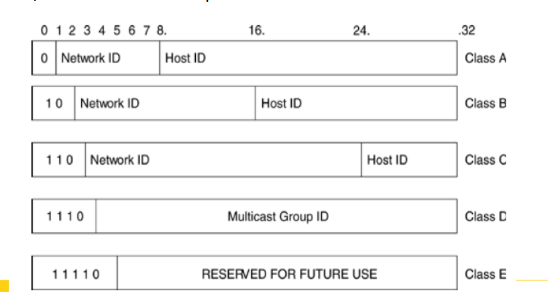
IP address
(Address)

Slide 8




Steps to create
a TCP application
Server Side
Single port gantry with Socket
Wait and listen for connection requests from incoming clients
Accept connection, create corresponding Socket
Transmit/receive information through the input/output streams of the Socket object
Close connection socket . bind . listen . accept . recv/send . close

Slide 9
Steps to create
a TCP application
Client side
Create a TCP socket with the IP address and port number on which the server program is running
Set up connection to the Server
Exchange data with the Server
Close Socket connection . connect . send/recv . close

